Slide 1
Business Rules
12 September 2013
Notes:
Guidewire training materials contain Guidewire proprietary information that is subject to confidentiality and non-disclosure agreements. You agree to use the information in this manual solely for the purpose of training to implement Guidewire software solutions. You also agree not to disclose the information in this manual to third parties or copy this manual without prior written consent from Guidewire. Guidewire training may be given only by Guidewire employees or certified Guidewire partners under the appropriate agreement with Guidewire.

Slide 2
Lesson objectives
By the end of this lesson, you should be able to:
Explain the functionality of business rules
Describe the Gosu techniques unique to business rules
Write business rules
Use Studio debugger to debug business rules
This lesson uses the notes section for additional explanation and information. To view the notes in PowerPoint, choose View→Normal or View→Notes Page. If you choose to print the notes for the lesson, be sure to select “Print hidden slides.”

Slide 3
Lesson outline
Business rules overview
Rules-specific Gosu
Working with rules
Debugging rules

Slide 4

Business rules
A business rule is Gosu code that:
Accomplishes some task for given entity, and
Executes when specific event occurs to instance of that entity
TrainingApp Example
ABContact pre-update rules
Execute actions required by change to an ABContact, such as:
Creating history entry to record change of assigned user
Setting a company's Primary Contact to null if the original Primary Contact no longer works for the company
Triggered when ABContact object is created or modified

Slide 5
Examples from Guidewire applications
PolicyCenter: account validation rules
Verify that account is valid before committing it to database
Triggered when account is created or modified
BillingCenter: activity escalation rules
Escalate activity that is open for too long
Triggered when activity is open past its escalation date
ClaimCenter: claim assignment rules
Assign given claim to a group and user
Triggered when claim is created or needs reassignment

Slide 6
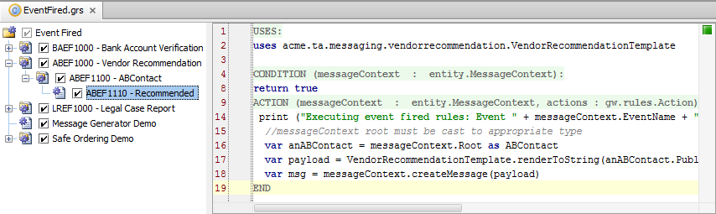
Rule set editor
View and edit Rule Set and Rules
Changes requires application restart unless using DCEVM
Rule Editor
Rule Hierarchy
Rule Hierarchy
Context menu
Activate/Deactive checkbox
Drag-and-drop ordering
Rule Editor
Overlays segment Uses, Condition, and Action
Gosu code for condition and actions
Notes:
You can think of a rule set as a logical grouping of rules that are specific to a business function. You typically organize these rules sets into a hierarchy that fits your business model. Guidewire strongly recommends that you implement a rule-naming scheme that is hierarchal in nature. A hierarchal naming convention will reflect the hierarchal structure when you create rules and organize rules into a hierarchy. However, the naming scheme for rules corresponds to the file structure on disk. So, if it has too many levels customers can run into problems with file names being too long on Windows.
A rule set combines many individual rules into a useful set to consider as a group. A rule set is a collection of rules that share the same root entity and share common triggers. In the example above, the rule set is EventFired.grs. Selecting the rule set in the editor displays the rule set description and details the root entity. In this example, the root entity is entity.MessageContext.
In a rule set, a Guidewire application evaluates the individual rules recursively in the hierarchy, unless an exit action is encountered. The process starts with the first direct child of the root and then evaluates all children and siblings. All rules in a rule set are processed unless an explicit "exit" is encountered.
Individual rule files have the file extension .gr. For each rule, there is a condition and action. The Rule Editor provides overlays to segment the condition and action. When a rule condition evaluates to true, the Guidewire application executes the rule action.
An inactive rule is not executed. You can activate and deactivate rules to get the rules engine to selective process and ignore rules. To deactivate a rule, disable the check box that appears to the left of the rule name. Inactive rules appear in gray. To reactivate the rule, enable the check box. To delete or rename a rule, right-click the rule and select the appropriate command from the context menu.
Rule changes require an application restart. If you are using a Dynamic Code Evolution Virtual Machine (DCEVM), press Alt + Shift + L on a running instance to deploy the changes.

Slide 7
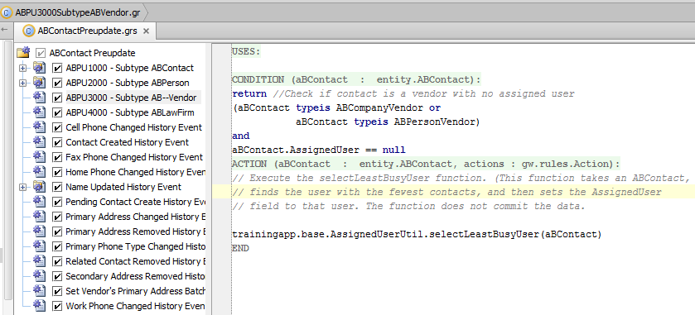
Business rule structure
Consists of name, condition, and action
Condition code must resolve to true or false
Action code executed only if condition is true
if
then
Notes:
Setting a rule condition to "true" means that the action will always performed whenever the rule is evaluated.
Notice that there is no "if" in the condition. This is assumed. The only valid condition is a boolean expression.

Slide 8
Business rule hierarchy
Three levels (from highest to lowest)
Rule set categories
Rule sets
Rules (which may be multi-leveled if child rules are present)

Slide 9
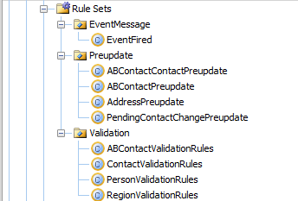
Hierarchy: rule set categories
A rule set category is a collection of rules that have common high-level business purpose
Studio uses rule set categories to group similar rules together
Notes:
You can create new rule set categories. This is recommended only in the uncommon situation of an implementation that needs a new type of rule set category that is completely unlike any existing rule set category, however. To create a new rule set category, right-click the Rule Sets node and select New > Rule Set Category. You can also create a rule set category as a child node of an existing rule set category if there is a need to subgroup rule sets.
The three rule set categories highlighted above: event messaging, pre-update, and validation, are triggered by the platform. This is true of all Guidewire applications and not just TrainingApp. If you create a new rule set category, you must also write the code necessary to trigger the rule sets. For more information, consult the Rules Guide.

Slide 10
Hierarchy: rule sets
A rule set is a collection of rules that are attached to the same entity and share the same trigger
For example, ABContact Pre-update rule set is attached to ABContact and triggers when any ABContact is created or modified
v
Notes:
Execution of rules always occurs at the rule set level. Unless the rules engine encounters an exit() command, all rules in the rule set are executed.
TrainingApp is built by heavily customizing an instance of ContactManager, and therefore has the same rule sets as ContactManager. These include:
The Event Fired rule set, which is associated with MessageContext and triggers when a MessageContext object fires an integration event.
The ABContact Validation rule set, which is associated with ABContact and triggers when an ABContact object is created or modified. ABContact Validation rules are designed to identify invalid changes to ABContacts. ABContact Pre-update rules are designed to take actions required because of changes to an ABContact.
The Region Validation rule set, which is associated with Region and triggers when a Region object is created or modified.
You can create new rule sets. To create a new rule set, right-click the appropriate rule set category node, select New → Rule Set, and associate an entity type.
For custom entities, you can create new pre-update and validation rule sets that are triggered whenever an instance of that entity is created, changed, removed, or retired. If an entity has an associated child entity that is set to trigger validation, then changes to a child object trigger validation and pre-update rules for the parent object.
You can also create non-pre-update, non-validation rule sets. These rule sets will not be triggered automatically, however. You must also write the code necessary to trigger the rule sets.
For more information on creating new pre-update, validation, or other rule sets, consult the Rules Guide.

Slide 11
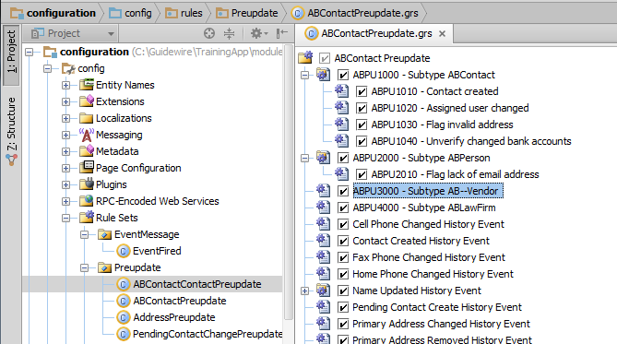
Hierarchy: business rules
A business rule is a set of one or more lines of code that typically executes one logical action
Rules can have child rules
If parent condition is true, parent action is executed and then child rules are executed
Notes:
If a rule has child rules, but the parent rule condition is false, neither the parent action nor the child rules are executed.
In the example above:
ABPU1000 gathers together the rules relevant for all contacts.
ABPU1010 creates a new history event when a contact is created.
ABPU1020 executes the necessary actions when a contact's assigned user changes (such as creating a note to record the change).
ABPU1030 executes the necessary actions when a flagged contact is unflagged (such as creating a note to record who unflagged the contact).
ABPU2000 checks to see if the contact is an ABPerson. The child rules are executed only if this condition is true.
ABPU2010 flags any person who does not have an email address.
ABPU2020 sets a company's Primary Contact to null if the original Primary Contact no longer works for the company.
ABPU-3000 checks to see if the contact is an ABPersonVendor or ABCompanyVendor. The child rules are executed only if this condition is true.
ABPU3010 (not shown) sets the preferred vendor flag if the contact's score is not null.
You can create new business rules. By providing an appropriate rule condition, you can also configure whether a given rule's action is executed or not.

Slide 12
Rule names
Guidewire recommends establishing and using a rules naming convention such as CodeNumber Purpose, where:
Code is a 4-character code related to rule set name
Number is a 4-digit unique number
Purpose identifies purpose of rule
Code: ABPU
Number: 1010
Purpose: Contact Created
Notes:
Guidewire recommends that you include the code and number of the rule that is being executed in logging statements and certain user-displayed messages such as validation errors. For example, a logging statement might state "Contact reassigned to user Alice Applegate. (ABPU1010)" or "Doctor's license date cannot be set to a future date. (ABVA2355)". Including the code and number makes it easier to determine which rule triggered the behavior.

Slide 13
Lesson outline
Business rules overview
Rules-specific Gosu
Working with rules
Debugging rules

Slide 14
Root entity
Every rule set has "root entity"
Identifies entity with which rule set is associated
Every rule has access to object that triggered rule set
Object has same name as root entity
"aBContact" is ABContact object which triggered rule set

Slide 15
Normal flow of execution
When triggering event occurs:
Rules executed in order listed in Studio
If rule has child rules and parent rule condition is true, parent action executed first, then child rules executed
All rules in rule set executed unless explicit "exit" encountered

Slide 16
Two logical types of rule sets
"Execute all"
All rules in rule set executed
Example: validation rules
All validation conditions are checked, regardless of how many are true
"Exit after first action" rule sets
When first true condition is found, action taken and rule set is exited
Example: assignment rules
Once one assignment is made, rule set should be exited to prevent later rules from reassigning object
Notes:
All of the rule sets in TrainingApp are "execute all" rule sets.
Additional examples of "exit after first action" rule sets include:
PolicyCenter role assignment rules, which find a user (such as Alice Applegate) to assign to a given account (such as Big Lake Bakery) or policy transaction (such as Big Lake Bakery's workers' comp policy). The user is assigned to the account or policy transaction with a given role (such as underwriter).
BillingCenter trouble ticket assignment rules, which find a user (such as Aaron Applegate) to assign a trouble ticket to (such as a dispute from an account stating they were overcharged for a policy).
ClaimCenter segmentation rules, which segment a claim to determine how to process it (such as segmenting a personal auto claim in which a falling tree caused minor damage as "auto-low_complexity").

Slide 17
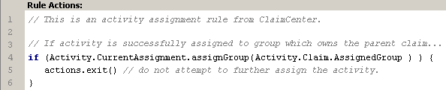
Exiting a rule set
Typically done only in rules in "exit after first action" rule sets
Syntax: actions.exit()
Example:
Notes:
The actions object actually has multiple exit methods, though exit commands almost always need to exit the entire rule set, and therefore exit() is used almost exclusively. The available exit methods include:
actions.exit() - Exit the entire rule set
actions.exitAfter() - Execute this rule's child rules and then exit the rule set
actions.exitToNextParent() - Skip to the next rule that is at the same level as this rule's parent
actions.exitToNextRoot() - Skip to the next top-level rule
actions.exitToNext() - Stop processing the current rule and immediately go to the next peer rule (the next rule at the same level in the hierarchy)

Slide 18
Lesson outline
Business rules overview
Rules-specific Gosu
Working with rules
Debugging rules

Slide 19
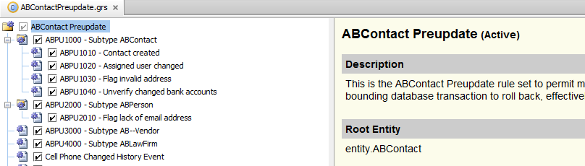
Rule set information
Selecting the rule set displays rule set description and lists root entity
Notes:
Recall that the root entity identifies the entity with which the rule set is associated. Every rule has access to the object that triggered the rule set. The object always has the same name as the root entity. For example, all ABContact pre-update rules have access to an object named "ABContact", which is the ABContact that has just been created or modified and which triggered the pre-update rule set.

Slide 20
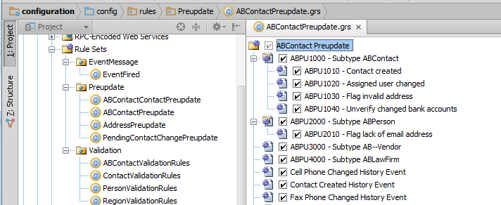
Rules in Studio
Project
Rule Set tab
Rule tab
Select a rule set in Project to display Rule Set tab
Select a rule in Rule Set tab to display Rule tab
Notes:
The "Resources" tab for a rule set contains three important tabs:
The Rule Set tab lists the hierarchy of rules in the rule set. Rules can be added to and removed from the hierarchy here.
The top of the Rule tab displays the condition for the selected rule. If the condition is true, then the code in the "Rule Actions" pane is executed (and any children rules are also executed). If the condition is not true, then the code is not executed (and no child rules are executed). This pane can contain only code that evaluates to true or false. Normally, conditions in Gosu are enclosed in parentheses. The rule condition pane has an implicit set of parentheses, however. The condition in this pane does not need to be enclosed in parentheses.
The bottom of the Rule tab displays the rule action. If the rule condition pane is true, then the code in the rule action is executed. This can contain any type of Gosu.

Slide 21
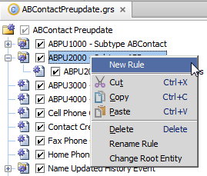
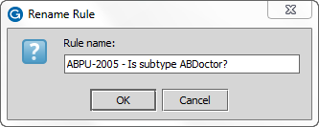
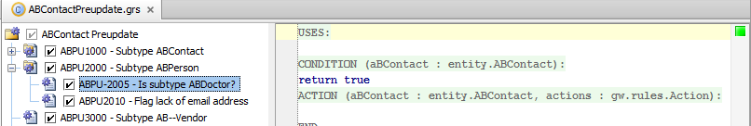
Creating new rules
Right-click rule parent
Rule defaults to true condition with no action
Notes:
You can also create a rule by selecting "Rule → New Rule" from the menu bar or using the hot key combination CTRL + Shift + N.

Slide 22
Rule conditions and actions
Use rule condition to:
Indicate if rule action should be executed
Control whether or not child rules are executed
If rule should always be executed, set condition to true
Notes:
For rules without child rules, the rule condition is intended to improve the readability of the code. You could ignore the condition and put all of the code in the actions. For example, the following rule...
Condition: ABContact.score != null
Action: ABContact.preferred = (ABContact.score >= 90)
...could be written as...
Condition: true
Action: if ABContact.score != null {
ABContact.preferred = (ABContact.score >= 90)
}
...but this approach is not recommended as it makes the purpose of the rule less apparent.

Slide 23
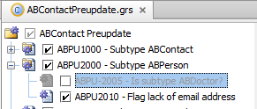
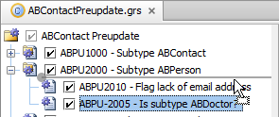
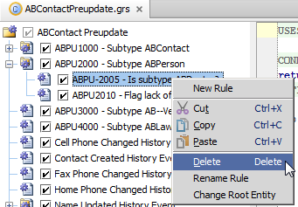
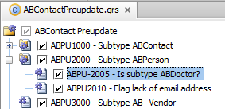
Working with rules
Moving rules
Deactivating/activating rules
Deleting and renaming rules
Notes:
To move a rule, click and drag the rule to the desired position.
An inactive rule is not executed. You can activate and deactivate rules to get the rules engine to selective process and ignore rules. To deactivate a rule, disable the check box that appears to the left of the rule name. Inactive rules appear in gray. To reactivate the rule, enable the check box.
To delete or rename a rule, right-click the rule and select the appropriate command from the context menu.

Slide 24
Deploying rule changes
If Dynamic Code Evolution Virtual Machine (DCEVM) is installed and Studio is connected to the application, you only need to save the rule
Changes to business rules are immediately
If DCEVM is not installed, then you must restart the server
The remainder of the course assumes that you do have the DCEVM installed
Notes:
If the DCEVM is installed but Studio is not connected to the application, then all you need to do is connect Studio to the application. Changes to business rules are deployed while Studio is establishing the connection.
The DCEVM should be used only in development environments. It should never be used in production environments.

Slide 25
Lesson outline
Business rules overview
Rules-specific Gosu
Working with rules
Debugging rules

Slide 26


Studio debugger
The Studio debugger is a set of tools that shows how code managed by Studio is executed
Helps you debug code that does not execute as expected
Useful for determining how rules are being executed
Available for most code managed by Studio, including:
Rules
Enhancements
Classes

Slide 27
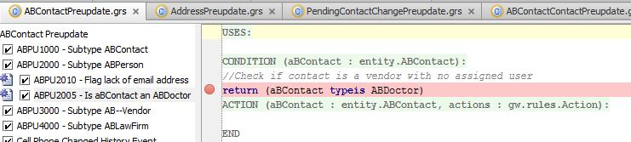
Setting breakpoints
A breakpoint indicates a place in code where execution should be suspended
After execution is suspended, you can step through code and observe:
Code that is executed
Variable and object values
To add breakpoint, click in area immediately left of line number
Notes:
When the debugger is on and a breakpoint is reached, normal execution of code is halted until you resume it. Because you can step through lines, you normally need only one breakpoint for each section of code you want to investigate. There is no advantage to having breakpoints on multiple consecutive lines because the first breakpoint suspends normal execution and normal execution does not resume until you request it to.
When the debugger is stopped, breakpoints are ignored and code is executed as normal.
Setting a Breakpoint
You can set a breakpoint by clicking in the gray area next to the line where the breakpoint symbol would appear. Alternatively, you can set breakpoints in one of the following ways:
On a particular line of code: Click in that line, and then select Debug →Toggle Line Breakpoint
On a particular rule: Click on or in the rule, and then select Debug → Toggle Rule Breakpoint. The debugger places a breakpoint on the rule condition, which is the first line of code executed in a rule.
Removing a Breakpoint
You can remove a breakpoint from your code by one of the following methods:
Click the breakpoint symbol (a red sphere)
Select Debug > Remove All Breakpoints
Position the cursor on line with a breakpoint and select Debug →Toggle Line Breakpoint
Position the cursor in a rule that is breakpointed and select Debug → Toggle Rule Breakpoint

Slide 28
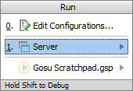
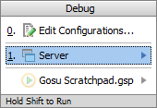
Run and debug server
Run Server (Alt + Shift + F10 )
Debug Server (Alt + Shift + F9)
Errors in Messages window
Console information and generated output in Run window
View running instance on jetty socket and port
Errors in Messages window
Debug window contains
Debugger and Console tabs
Console information and generated output to Console tab in Debug window
View running instance on jetty socket and port
Remember to set your breakpoints!
Notes:
In Guidewire Studio, you can run, debug (and test) your Guidewire application without leaving Guidewire Studio. You can run or debug your project by selecting the Run Server and/or Debug Server menu commands. In certain cases, you can use the Shift + F10 keystroke to Run Server and Shift + F9 keystroke to Debug Server. However, if you are actively working in Gosu Scratchpad (run/debug/stop), these keystrokes will run and debug, respectively, the code in Gosu Scratchpad! For this reason, you may want to use Alt + Shift + F10 and Alt + Shift + F9 to open the respective dialogs to run and debug the server instance for your project.
The console information and the generated output are displayed in the Run tool window or the Debug tool window in the Console tab.
The debugger enables you to execute your application step by step, examine program information related to variables, watches, or threads, and change your program without leaving Guidewire Studio. Prior to launching the debugger session, it makes sense to set breakpoints that cause the debugger to suspend the application or take some other actions when breakpoints are reached in code. There is no requirement for an explicit connection to running server. The same functionality supported by starting server in debug mode or by remote debugging,
No authentication is required to start debugging, however, debugging of production servers is not possible because they are not running in debug mode.

Slide 29
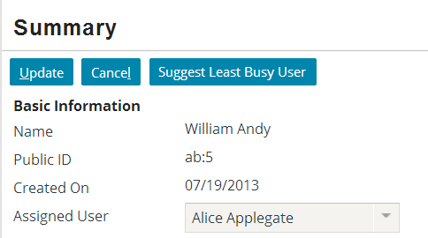
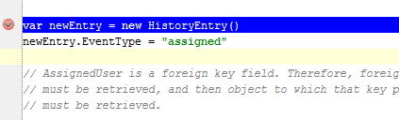
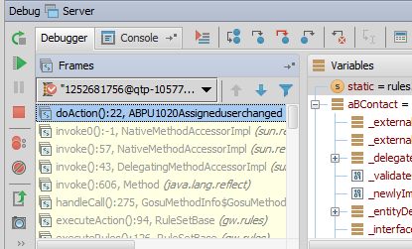
Suspending execution
When application executes code with breakpoint
Execution is suspended
Studio is automatically displayed with current line in blue
Frame tab shows current values of root and related objects
Notes:
The Frame tab lists the object passed to the code (for business rules, this is the root entity). Variable values at the breakpoint are visible in the Variables window. Frames shows the sequence of actions executed until the breakpoint, inclusive.

Slide 30
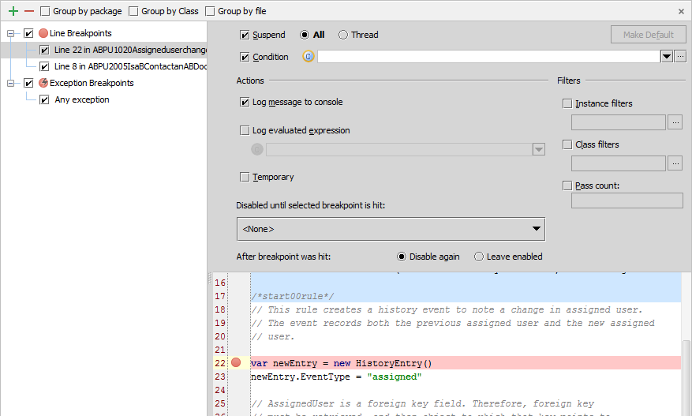
Breakpoint details
Run → View Breakpoints…
Ctrl +Shift + F8
Enable, disable, define action and conditions
Notes:
In addition to Ctrl-Shift-F8, right-clicking on the breakpoint also displays a menu with choices to Edit, Disable, Remove, or View Breakpoints. This screen shows the Edit breakpoint options.
The Breakpoint options dialog allows you to review all breakpoints. In the Toolbar, you can add a breakpoint, remove a breakpoint, display breakpoints under their respective packages rather than under their types, display breakpoints under their respective classes, and display breakpoints under their respective files. There are various Breakpoint options to set. You can enable a suspend policy for a breakpoint. For example, for a Thread policy the thread where the breakpoint is hit is suspended. You can also specify a condition in either Gosu or Java. You can also specify actions, such as logging the evaluated expression.

Slide 31
Stepping through code
Several step tools are available to help in debugging
Step over (F8) advances you to the next line in the file
Step into (F7) advances you to the next line executed
Force step into (Alt+Shift+F7) steps into, ignore stepping filters for libraries, constructors, etc.
Step out(Shift+F8) step to the first line executed after returning from this method
Notes:
Once the debugger pauses execution, you can step through the code in one of several ways. The most basic, stepping through code one line at a time, is achieved using Step Over (F8).

Slide 32

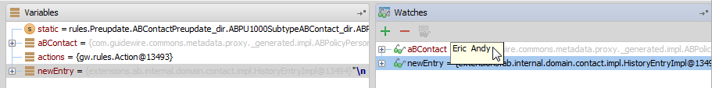
Watches
A watch is an expression whose value you wish to observe
To add a watch:
On Watches tab, right-click and select Add Watch
Drag the variables you want to watch from the Variables window to the Watches window
Notes:
The easiest way to populate the Watches window is to run the code to a desired point, then drag the variable over to the Watches window.

Slide 33
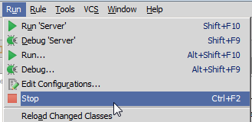
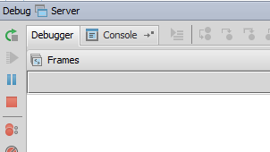
Stopping debugger
To stop debugger, click the stop button from the Run menu item, or within the debugger itself

Slide 34
Lesson objectives review
You should now be able to:
Explain the functionality of business rules
Describe the Gosu techniques unique to business rules
Write business rules
Use Studio debugger to debug business rules

Slide 35
Review questions
What is the significance of a rule set's root entity?
What triggers a rule set?
What two things are done for a rule whose condition is true that are not done for a rule whose condition is false?
What is the difference between an "execute all" rule set and an "exit after first action" rule set?
What is the effect of deactivating a rule?
What must you do to deploy changes to rules?
Notes:
Answers
1. Every rule set is tied to an entity, known as the root entity. This determines which class of objects the rule set is tied to. It also determines the object available to the rules in the rule set when the rule set is triggered.
2. A rule set is triggered when a given event occurs to any instance of the root entity. The actual event varies from rule set to rule set.
3. The rule action is executed and the child rules (if any) are executed.
4. In an "execute all" rule set, all rules are executed. For example, validation rule sets are execute all. All validation conditions are checked, regardless of how many are true. In an "exit after first action" rule set, you do not typically execute all rules. When the first true condition is found, the action associated with that condition is taken and the rule set is exited. For example, assignment rule sets are exit after first action. Once an assignment is made, the rule set exits so that later code doesn't reassign the object.
5. The rule is not executed by the rules engine, which is useful in development for turning rules "on" and "off".
6. Other than saving the changes to a rule, you do not need to do anything to deploy the rule. If Studio is connected to the application server, the changes are immediately available. (This also assumes that the DCEVM is installed.)

